Slide 1
OFFICE OF THE PREMIER Presentation to Oversight Committee on Office of the Premier and Legislature (OCPOL)
PROGRAMME PERFORMANCE REPORT
Quarter 2: July – September 2024/25
15 November 2024

Slide 2
PRESENTATION OUTLINE
Provincial Strategic Agenda
Performance Highlights
Non-Financial Performance
GEYODI Empowerment
Financial Performance
Life Esidimeni
Public Engagements
Request for Information
Departmental Human Capacity

Slide 3
PROVINCIAL STRATEGIC AGENDA
Strategic Priorities to inform Medium Term Planning
Alignment of GGT2030 to MTDP
Elevated Priorities Underpinned by a focus on TISH Areas
Alignment of Strategic Priorities Reporting

Slide 4
GNU AND GPU MTDP STRATEGIC PRIORITIES, 2024-2029
The GNU and GPU MTDP strategic priorities for the 7th Administration are anchored on three (3) priorities, namely:
Inclusive economic growth and job creation
Reduce poverty and tackle the high cost of living
Building a capable and developmental state
The focus of the 7th Administration will be on:
Strengthening governance;
Enhancing public safety;
Supporting the development and revitalization of municipalities and townships.
This strategic approach is expected to:
Drive meaningful progress and elevate the quality of life for Gauteng residents.
To enhance the effectiveness of governance, and to strengthen the fight against crime, in this regard the community safety portfolio has now been moved to the Office of the Premier. This restructuring is aimed at streamlining efforts to combat crime and improve public safety.
Additionally, the decision to establish the Department of Environment as a stand-alone entity underscores the commitment to address environmental and sanitation challenges whilst improving cleanliness across Gauteng.
4

Slide 5
THREE STRATEGIC PRIORITIES OF THE MTDP – ALIGNED TO THE NATIONAL
NDP Goals
Gauteng Vision and Dynamic Impacts
GNU/ GPU Priorities
MTDP Strategic Priorities, 2024-2029
Eradicate Poverty
Reduce Inequality
Build Social Cohesion
Reduce Unemployment
Increase
Economic Growth
The Gauteng of our dreams – ‘A province in step with itself and the nation’
An improvement in economic prosperity
A decline in the unemployment rate
A decline in the poverty rate
A decline in income inequality
An improvement in quality of life and wellbeing
Inclusive economic growth and job creation
1. Inclusive economic growth and job creation
Rapid, inclusive and sustainable economic growth to create jobs
Reduce poverty and tackle the high cost of living
2. Improved living conditions and enhanced health and wellbeing
A more just society and reduced poverty, and a skilled and healthy workforce, quality living environments and basic services
Investing in people through quality education and health care
Draft MTDP Strategic Themes
Rebuild the capability of the state
3. A capable, ethical and developmental state
Building a capable, ethical and developmental state in support of enhanced efficiencies and service delivery, and an enabling environment for inclusive economic growth
Improve the delivery of basic services and stabilise local government
Strengthen law enforcement agencies to address crime, corruption and GBVF
5

Slide 6
ALIGNMENT OF STRATEGIC PRIORITIES TO REPORTING
1
2
3
4
NDP/MTDP 2030 Priorities
5
GGT2030 Priorities/TISH
Strategic Plan Outcomes
APP Outputs
Reporting

Slide 7
standardised reporting TEMPLATE
EXECUTIVE SUMMARY
Request for information
DEPARTMENTAL CAPACITY
AGSA request for information
PSC request for information
Human resource capacity
STRATEGIC PRIORITIES
Departmental achievement of national strategic priorities
departmental achievement of provincial priorities
Departmental achievement of special strategic projects
GEYODI EMPOWERMENT
POSITIVE OUTCOMES OF DEPARTMENTAL PERFROMANCE
INTERNATIONAL RELATIONS
CHALLENGES/RISKS/REQUEST FOR INTERVENTIONS
RESOLUTIONS AND PETITIONS MANAGEMENT
Challenges
Risks
Request for interventions
DEPARTMENT FINANCIAL PERFORMANCE
Department budget expenditure figures
Department key financial indicators
IMPLEMENTATION OF LAWS BY THE DEPARTMENT
ADOPTION
NON-FINANCIAL PERFORMANCE
PUBLIC ENGAGEMENT BY THE DEPARTMENT
Premier
Director General
Performance as per app targets department
Emerging priorities
Performance verification and evidence
RESOLUTIONS AND PETITIONS MANAGEMENT
Source: Standardized Oversight, Accountability and Reporting for Gauteng Province (OCPOL, 2020)
Resolutions management
Petitions management

Slide 8
PROGRESS TOWARDS THE ELEVATED PRIORITIES ALIGNED TO 2020-2025 STRATEGIC PLAN
Quarter Two (2) of the Annual Performance Plan (APP) for the 2024/25 financial year continues delivery against the 2020-2025 Strategic Plan, Gauteng Growing Together 2030 Plan and the elevated priorities as confirmed by the Premier in his State of the Province Address in February 2024.
The last year of the 2020-2025 Strategic Plan, a focus was made on Townships, Informal Settlements and Hostels (TISH) in the following priorities
Accelerated economic recovery
Strengthen the battle against crime, corruption, vandalism, and lawlessness
Improve health and wellness of communities
Strengthen the capacity of the state to deliver services
Focus on incomplete Infrastructure investment
The Adjusted APP for 2024/25 reflects the updated focus areas of the 7th Administration as pronounced by the Premier in his State of the Province Address in August 2024 and aligns with the emerging Gauteng Medium-Term Development Plan (GMTDP)

Slide 9
Q2 PERFORMANCE HIGHLIGHTS IN RESPONSE TO THE ELEVATED PRIORITIES
Response to Elevated Priority 1: Economic recovery and acceleration
Response to Elevated Priority 2: Strengthen the Battle Against Crime, Corruption, Vandalism
Response to Elevated Priority 3: Improving Living Conditions in Townships, Informal Settlements, and Hostels
Response to Elevated Priority 4: Health and Wellness
Response to Elevated Priority 5: Strengthen the Capacity of the State

Slide 10
Economic recovery and acceleration
ENERGY SECURITY
With the support from the Minister of Electricity, Gauteng’s energy situation has stabilised, allowing for more predictable energy supply to power our economy.
Load shedding disruptions have been minimised, improving productivity and reducing operational risks for businesses and households alike.
The Transformer replacement programme is underway in Soweto (Jabavu, Mofolo South and Braamfischerville)
All preliminary work and approvals have been received for Priority Energy Projects. Implementation will start in Quarter 3
The Province is working with municipalities to formulate a strategy to harness the 5000 MW path (A successful workshop was held on 9th September 2024, with key takeaway points to be incorporated into the strategy)
Premier’s Energy Emergency Council has approved the following priority projects for the current financial year:
Solar PV and battery energy storage systems (BESS)
A total number of 28 facilities were earmarked for rooftop solar PV and battery energy storage solutions.
A total number of 27 facilities have been completed and commissioned.
South Rand Hospital is completed but has not been commissioned. Preparations are currently underway to commissioning, testing, and signing off.

Slide 11
Eskom Summary Progress - Transformers
 | Transformers Replacement Programme (522)
Zone | Project Details |  |  |  | Progress
 | Area | Planned | Compliant | Replaced | Previous Progress 28-08-2024 | Current Progress 28-08-2024 | Under Construction
Ekurhuleni | Benoni | 7 | 0 | 9 | 0 | 0 | 0
 | Nigel | 14 | 0 | 20 | 0 | 0 | 0
Johannesburg | Sandton | 53 | 9 | 76 (73) | 2 | 2 | 7
 | Soweto | 84 | 1 | 122 (117) | 3 | 1 | 2
Tshwane | Tshwane East | 5 | 0 | 5 | 0 | 0 | 0
Tshwane | Tshwane West | 76 | 6 | 69 (67) | 0 | 2 | 3
Vaal | Randfontein | 66 | 0 | 66 | 0 | 0 | 0
Vaal | Vereeniging | 217 | 29 | 162 (148) | 5 | 1 | 7
Total |  | 522 | 54(45) | 529(505) | 10(4) | 6(5) | 19(22)
24 transformers replaced since 13th August 2024 to date
Benoni, Nigel, Tshwane East, Randfontein are completed
 | Present Update (11th Sep 2024)
 | Previous Update (13th Aug 2024)
Notes:
Ready to implement projects

Slide 12
Economic recovery and acceleration
ENERGY SECURITY Cont…
Evaton Electrification Programme
Collection of ward information for Evaton electrification programme is at an advanced stage (ward 43 and 44 outstanding)
8 wards in Evaton (18,19,29,38,41,42,43,44) were evaluated.
Some wards in Evaton includes areas that are not earmarked for electrification programme (Sebokeng Zone 6, 7 and Kanana)
Application for electricity connections from the municipality was for 82 705 (this has a bearing on the backbone infrastructure needed to accommodate these connections)
Six (6) wards have submitted household information and information on two (2) wards is outstanding (Ward 43 and Ward 44)
Site visits were conducted on 25 August 2024 to ascertain households that can benefit from microgrid option.
Eskom is currently busy with preliminary designs of the microgrid.
12

Slide 13
Economic recovery and acceleration
PREFERENTIAL PROCUREMENT
The Office of the Premier procurement spend on targeted groups was as follows for Q2:
GPG wide procurement spend:
PAYMENT OF INVOICES
99.36% (309 out of 311) valid invoices paid within 15 days from the date of receipt
Despite the shortfall, the OoP achieved 100% payment of invoices within 30 days of receipt, in accordance with legislative framework
Targeted Group | %Spent | Target
Black people | 94% | 80%
Women | 47% | 40%
Youth | 37% | 15%
People with Disabilities | 0.53% | 7%
Township | 43% | 40%
The Office of the Premier in Gauteng is launching several initiatives, including a dedicated War Room and SMME workshops, to boost procurement opportunities for businesses owned by persons with disabilities, while also implementing a B-BBEE Incubation Programme to support their growth and sustainability
Targeted Group | %Spent | Target
Black people | 53.18% | 80%
Women | 5.81% | 40%
Youth | 9.90% | 15%
People with Disabilities | 0.07% | 7%

Slide 14
Economic recovery and acceleration
FOREIGN DIRECT INVESTMENT
The annual target for Foreign Direct Investment (FDI) facilitated in the 2024/25 financial year is R15 billion with a target of R2 billion for the first quarter. Only one project worth R28.7 million was facilitated
DOMESTIC DIRECT INVESTMENT
The annual target for Domestic Direct Investment (DDI) facilitated in the 2024/25 financial year is R10.5 billion with a target of R1 billion for the first quarter. Only one project worth R450 million was facilitated

Slide 15
STRENGTHEN THE BATTLE AGAINST CRIME, CORRUPTION, VANDALISM
CASES REFERALS
100% (4 out of 4) of cases recommended for referral to Law Enforcement Agencies (LEAs) for criminal investigation have been reported to LEAs by the departments during the quarter under review.
Two (2) cases are from Department of Roads and Transport
Two (2) cases are from Department of Agriculture and Rural Development
National Anti-Corruption Hotline cases
The Provincial Forensic Audits (PFA) received 581 National Anti-Corruption Hotline (NACH) cases from the Office of the Public Service Commission (PSC) from 01 April 2014 to 30 September 2024.
Seven (7) cases were received in the quarter under review
Four (4) cases were received in August 2024 (3 from Department of Education and 1 from Department of Human Settlements)
Three (3) case was received in September 2024 (2 from Department of Human Settlements and 1 from Department of Social Development)
Cumulatively, there are 576 out of 581 cases finalised which translate to 99% of cases finalised and closed on the database.
Only 5 cases translating to 1% are still outstanding as at 30 September 2024
15

Slide 16
STRENGTHEN THE BATTLE AGAINST CRIME, CORRUPTION, VANDALISM
VETTING OF OFFICIALS
There are a total of 751 SMS-filled posts
174 are vetted
532 are awaiting feedback.
45 SMS officials within GPG have not yet applied for security clearance
The significant increase in the number of SMS members awaiting vetting feedback is due to re-application for vetting by members whose security clearance has expired.
There are a total of 2174 SCM filled posts,
279 are vetted
1855 are still awaiting feedback
40 SCM officials within GPG have not yet applied for security clearance.
The matter of officials who did not apply for vetting was escalated with relevant HOD’s, emphasizing the need for compliance by 15 November 2024.
16

Slide 17
IMPROVING LIVING CONDITIONS IN TOWNSHIP, INFORMAL SETTLEMENTS AND HOSTELS
Ntirhisano outreach programme
President Cyril Ramaphosa, accompanied by Premier Panyaza Lesufi, held the first District Development Model (DDM) Imbizo for the 7th Administration at Tsakane Stadium in Ekurhuleni, Gauteng, on 23 August 2024.
This event aimed to improve coordination among the three levels of government—national, provincial, and local—by enhancing planning, budgeting, and implementation at the local level.
On 20 July 2024, the Gauteng Provincial Government launched free access to Wi-Fi through the Gauteng Provincial Network (GPN) for residents of Kromdraai.
This initiative aims to help Gauteng residents access services online and enjoy free internet, allowing them to engage in digital activities that can enhance their education, skills, and career opportunities
The FSDM monitoring programme focused on the monitoring of Government service points as well as assess experience of citizens in their interaction with government facilities
A total of 53 site visits (cumulative) have been conducted and improvement plans facilitated (26 in Q1 + 27 in Q2)
100% of commitments have been tracked for progress as at 31 March 2024. This is made up of 13 commitments carried over from the Sedibeng DDM imbizo of 2023/24
A further 17 commitments have been added from the Ekurhuleni DDM imbizo of 23 August 2024 whose tracking will commence in quarter 3

Slide 18
OVERALL PERFORMANCE AGAINST THE 12 COMMITMENTS
Achieved: A total of 8 commitments (67%) have been achieved.
In progress: There is good progress in resolving 4 commitments (33%) made, with processes underway or on track.
New commitments to be included for tracking in Q3 in following the Presidential Imbizo in Ekurhuleni Metropolitan Municipality held on 23 August 2024

Slide 19
KEY COMMITMENTS: SEDIBENG DISTRICT MUNICIPALITY
COMMITMENTS | RESPONSIBILITY | RATING
Address challenges in the Obed Nkosi projects where it was indicated that the development is in a waterlogged area. The Minister will return to the areas in waterlogged stands. | DHS | Achieved
Government to address the illegal occupation of land. Government to establish a team to deal with evictions | DHS, SDM | Achieved
Develop a strategy for dealing with poor infrastructure conditions in hostels. | DHS, SDM | Achieved
Fast-track the provision of electricity in Sebokeng Zone 17 Clinic and ensure that the facility is operationalised. | DOH, DID, Eskom | Achieved
Fast-track the renovations of the Vereeniging Fresh Produce Market | GDARD, SDM | In progress
Acquisition of commonage land to address concerns on the provision of land for livestock | SDM | In progress
Resolve the scholar transport contact challenges | GDE | Achieved
Artisan programme in SDM | Higher Education and Training | Achieved
Government to partner with the private sector in the provision of accommodation for learners in TVET Colleges | Higher Education and Training | Achieved
Resolve the Eskom and Rand Water debt | ELM | In progress
Construction of Vaal River City Interchange | DRT | In progress
Vereeniging Intermodal Facility (Phase 1) | DRT | Achieved
5

Slide 20
EKURHULENI METROPOLITAN MUNICIPALITY COMMITMENTS
COMMITMENT | RESPONSIBLE DEPARTMENTS
Establishment of the Mapleton pump station project, aimed at improving water access for the Tsakane community | Ekurhuleni Metropolitan Municipality
Council resolution for the re-establishment of the District Development Model | Ekurhuleni Metropolitan Municipality
Conclusion of the appointment of 1400 additional EPWP | Ekurhuleni Metropolitan Municipality
Building of a university in Ekurhuleni | Ekurhuleni Metropolitan Municipality, Department of Higher Education
Introduce the e-indigent register in October 2024 | Department of Social Development
Broadening access to ICT by providing Wi-Fi connectivity to the 26 proclaimed townships. | Department of eGovernment
Through the Shared Economic Infrastructure Facility programme, a building will be opened in at Springs in September 2024 to accommodate the small businesses identified by the municipality. | Department of Small Business Development
Amendment of the Marketing of Agriculture Products Act to ensure alignment with the agricultural sector needs, farmers will be widely consulted on the matter. | Department of Agriculture

Slide 21
EKURHULENI COMMITMENTS
COMMITMENT | RESPONSIBLE DEPARTMENTS
Land allocation for Kwa-Thema Police Station, with the goal of establishing a new, properly equipped facility. | SAPS, Ekurhuleni Metropolitan Municipality
Connection of 3 transformers that were delivered in Tsakane ext 16 | COGTA, ESKOM
Delivery of transformers in ext 8, 9 and 13 | COGTA, ESKOM
Assisting struggling municipalities in developing turnaround plans, aiming to make municipalities fully functional within twelve months. | COGTA
Televise rugby matched on SABC, starting with the next SA and New Zealand Rugby | Department of Sports, Arts and Culture
Resume the application process for the teacher assistants programme by end of August 2024 | Department of Basic Education
A provincial public transport tender to be concluded by the end of 2024. | Department of Transport
Development of a new Roads and Safety Strategy in response to the rising number of road accidents | Department of Transport
Province to host a conference on township markets (President’s request at the Imbizo briefing) | Department of Economic Development

Slide 22
Strengthen the capacity of the state
SERVICE DELIVERY INTERVENTIONS CASE RESOLUTION
The Gauteng City-Region Integrated Service Delivery Response System has four components:
Central Service Delivery War Room and Central Information Centre
CRM and Rapid Response System that connects all Departments and municipalities
GCR-wide Response Network (i.e. Community workers and Response Teams)
Outreach Programme
The DPSA Complaint Management Framework was also considered in the implementation of the system
A memorandum of understanding was introduced to address governance issues and regulate the relationship with other spheres of government, role clarification challenges in the implementation
Performance to date:
The service delivery cases are better tracked at cumulative level (i,e. from inception to date) because delivery in some of the requests requires short, medium, and long-term planning
The cumulative case resolution rate as of the end of Quarter 2 is 68.23%.
The reach in terms of wards is at 531 since inception and 161 for the quarter under review
22

Slide 23
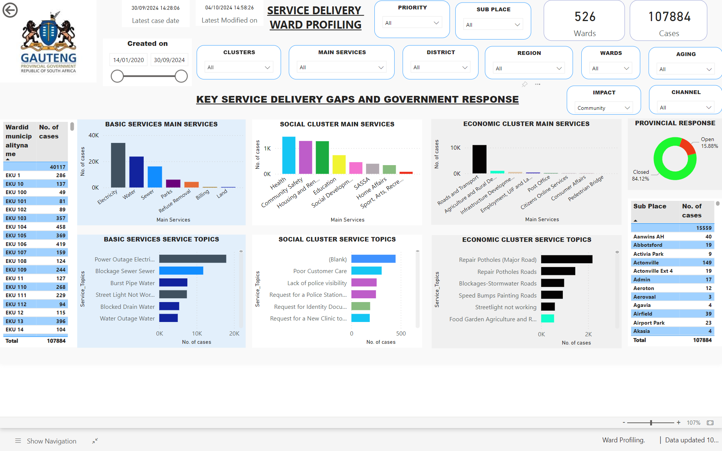
23

Slide 24
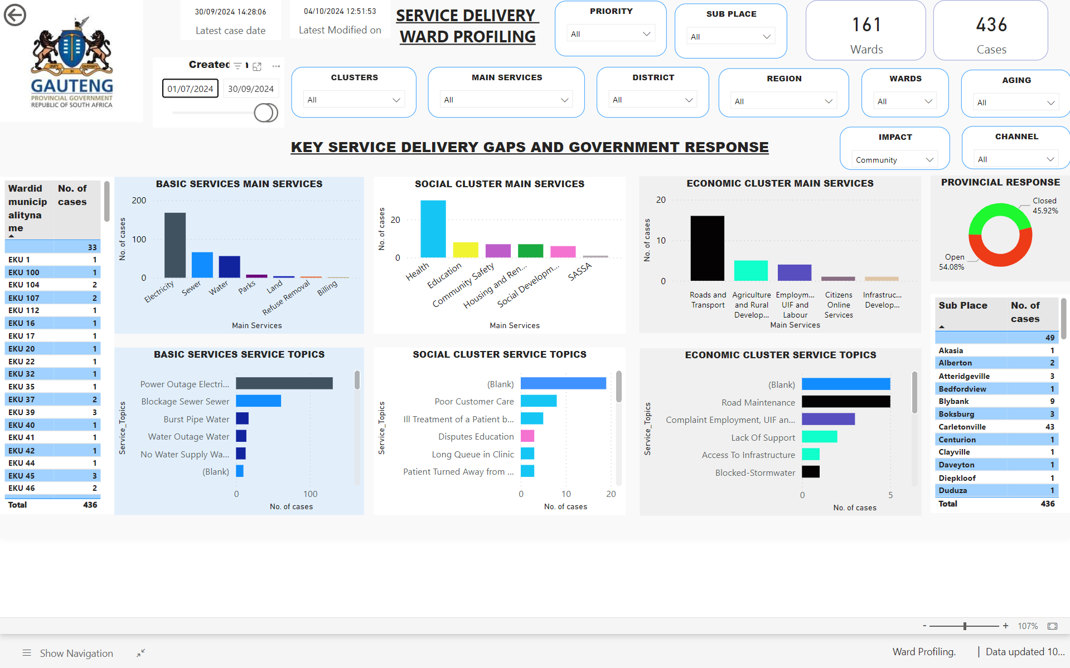
24

Slide 25
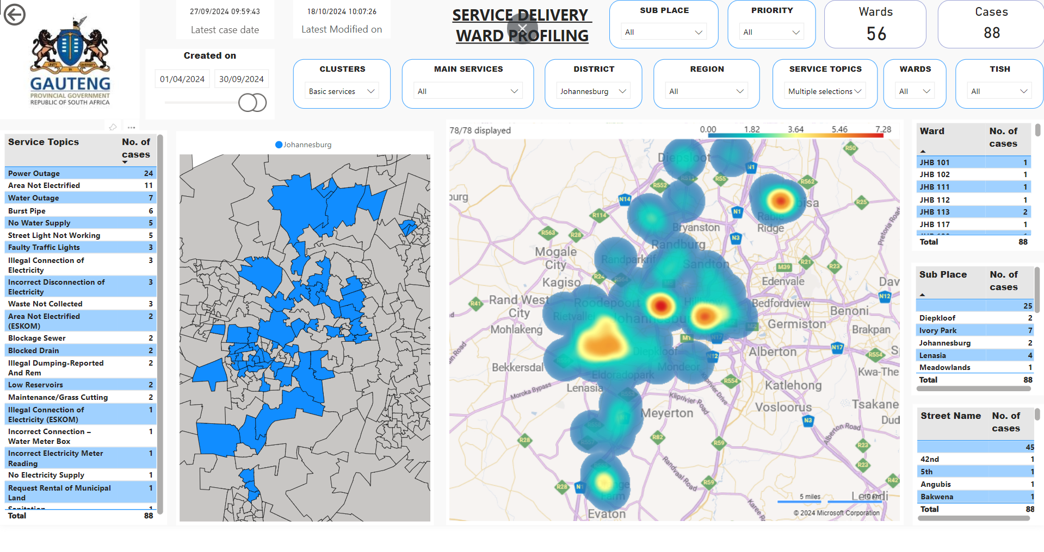

Slide 26
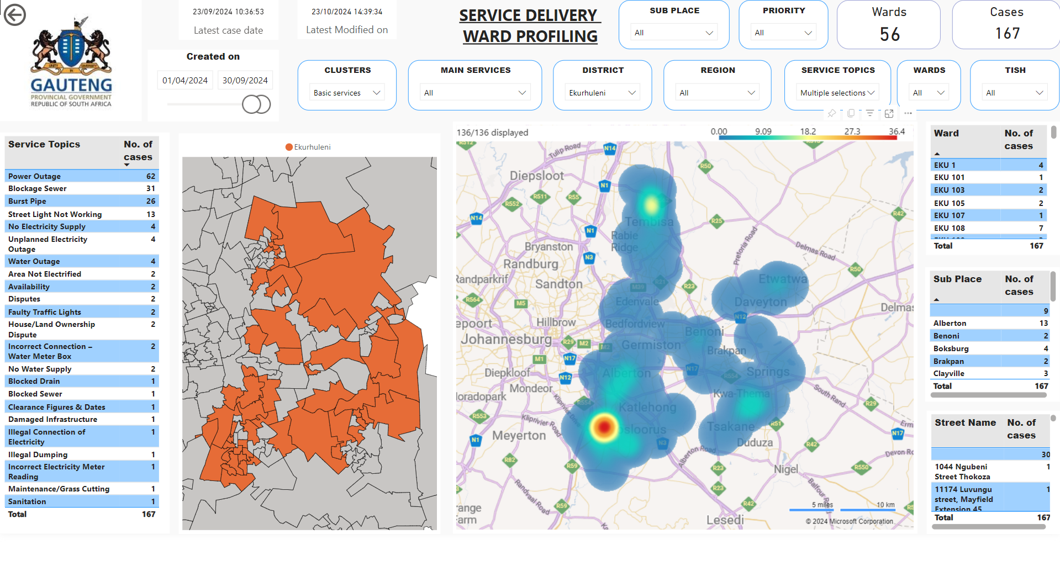

Slide 27
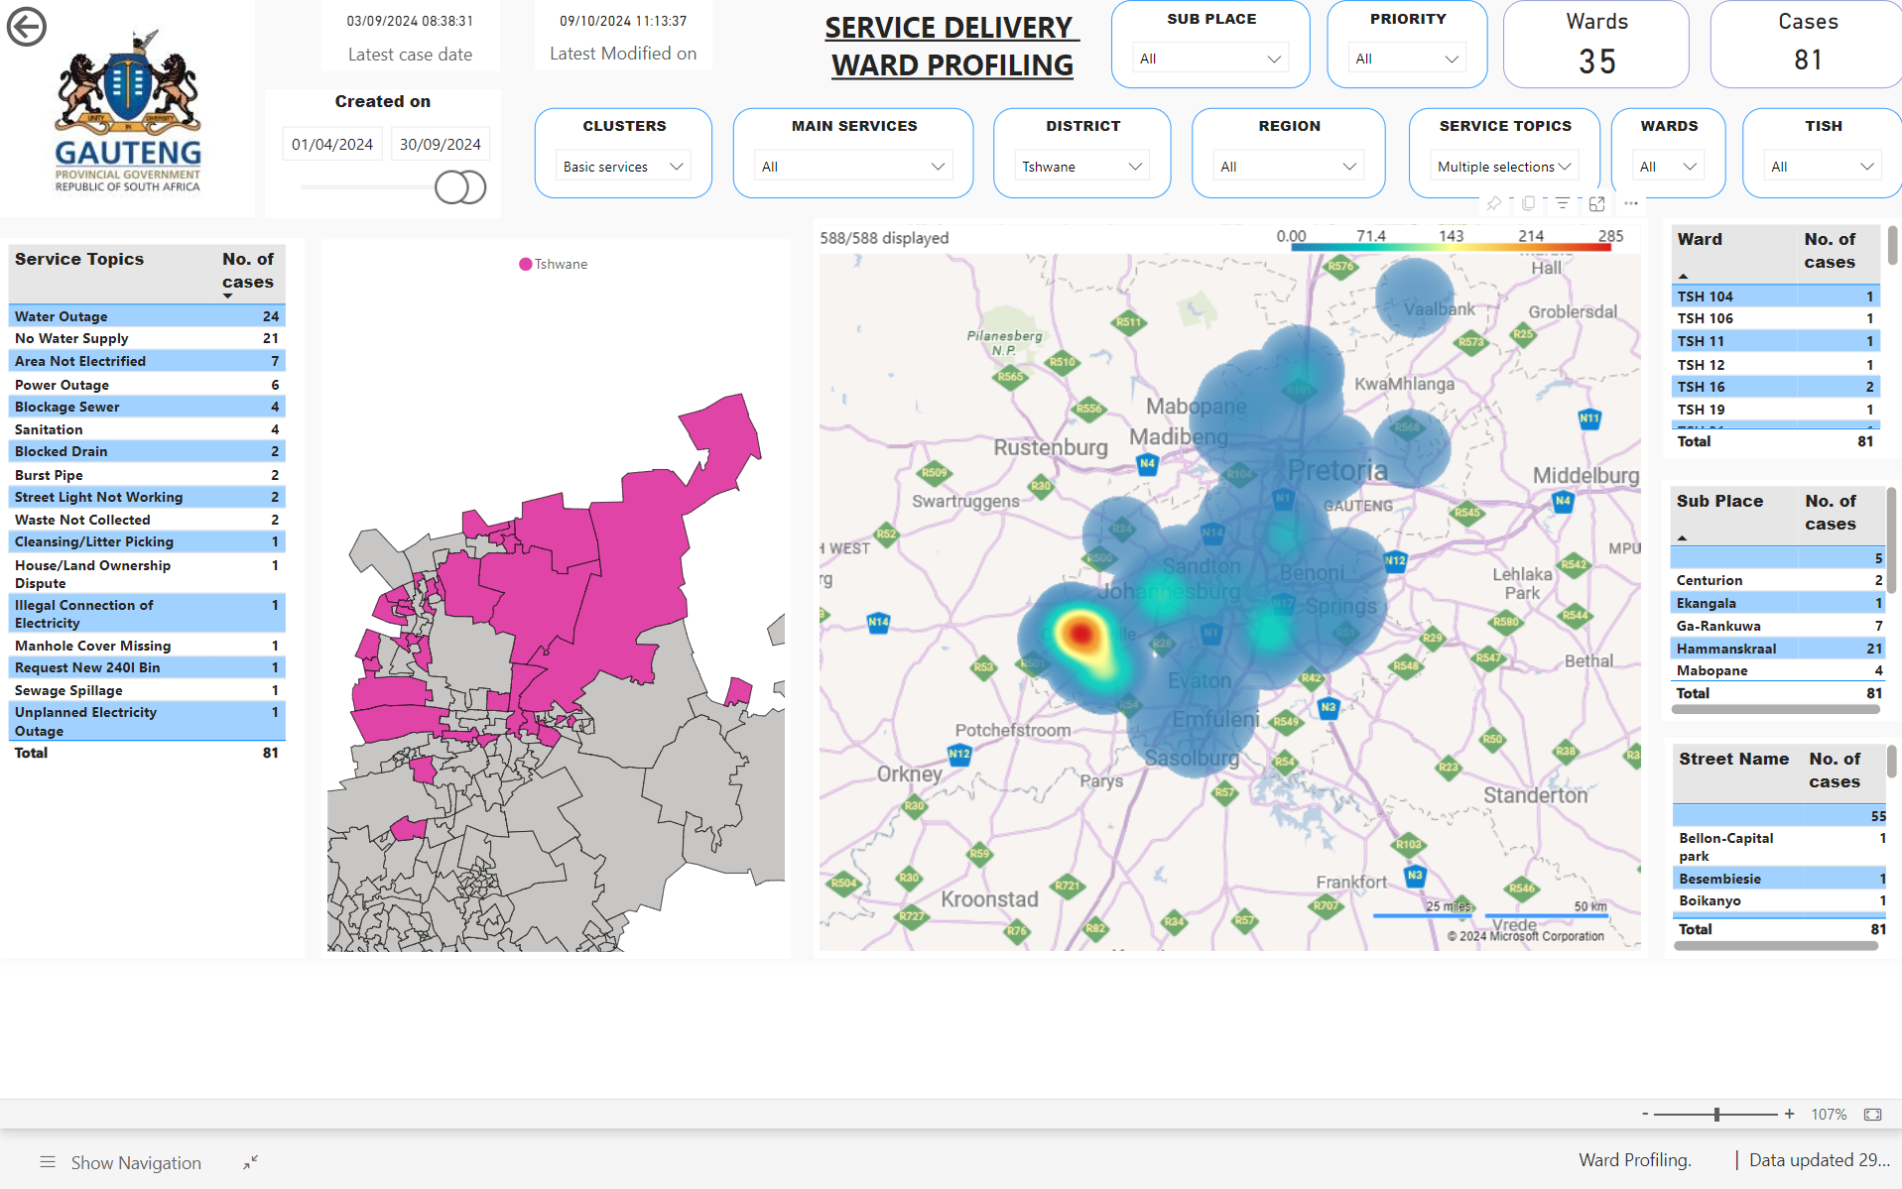

Slide 28
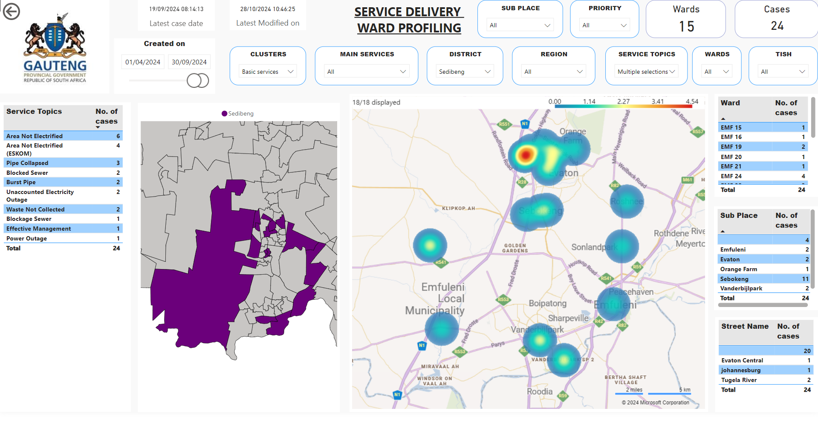

Slide 29
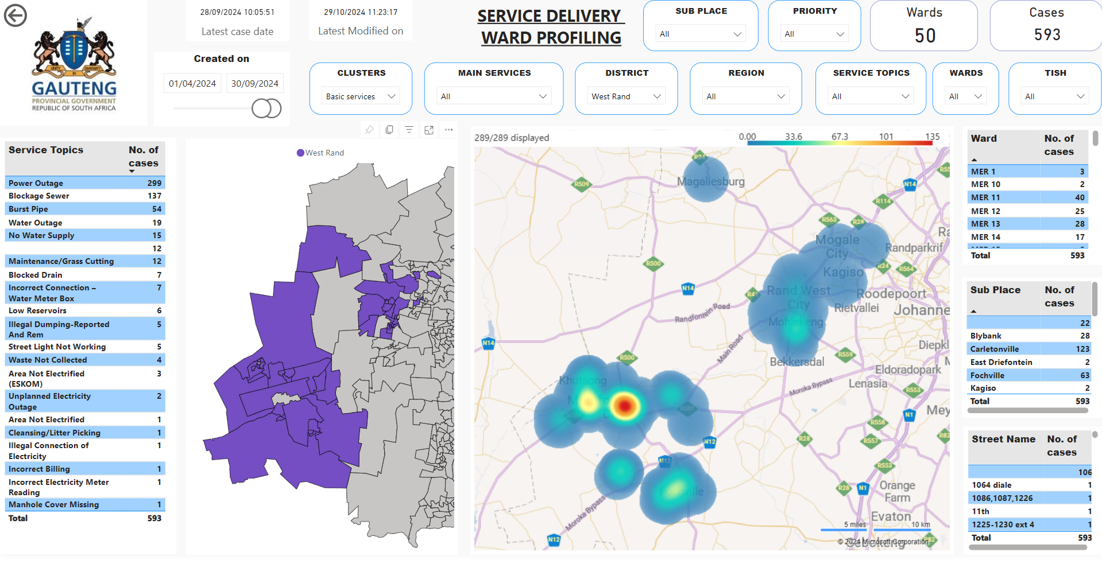

Slide 30
Q2 PROGRAMME PERFORMANCE

Slide 31
NON-FINANCIAL PERFORMANCE REPORT
2024/25FY non-financial performance
Total KPIs for Q2 2024/25 | 44
KPI’s achieved | 35
Percentage achieved | 80%
KPI’s not achieved | 9
Percentage not achieved | 20%
31

Slide 32
Q2 OVERALL PROGRAMME PERFORMANCE
Programme | % Achieved Q2 | Q2 No. of Indicators | Q2 No. of indicators Achieved | Q2 No. of indicators not achieved
Programme 1 | 67% | 9 | 6 | 3
Programme 2 | 100% | 11 | 11 | 0
Programme 3 | 75% | 24 | 18 | 6
Overall | 80% | 44 | 35 | 9
OVERALL ACHIEVEMENTS
A total of 44 indicators reported for the quarter under review
80% (35 out of 44) indicators were achieved for Quarter 2
Programme 1 is the least performing programmes
Programme 2 is the best performing programme in the quarter under review

Slide 33
PROGRAMME 1 QUARTER 2 PERFORMANCE
PROGRAMME 1 ACHIEVEMENTS
Out of 751 SMS-filled posts, 174 were vetted and 532 are awaiting feedback.
Out of 2174 SCM-filled posts, 279 were vetted and 1855 are still awaiting feedback, 40 SCM officials have not applied for security clearance
Preferential Procurement:
Black spent=94% against the target of 80%
Women spent =47% against the target of 40%
Youth spent = 37% against the target of 15%
Township spent = 43% against the target of 40%
PROGRAMME 1 AREAS OF UNDERPERFORMANCE
99.36% (309 out of 311) of valid invoices paid within 15 days from date of receipt
Preferential Procurement:
Only 0.53% was spent on PwD against the set target of 7%
Skills Audit recommendations
0% of recommendations implemented on the skills audit conducted for levels 1-12

Slide 34
PROGRAMME 3 QUARTER 2 PERFORMANCE
PROGRAMME 3 ACHIEVEMENTS
GPG wide procurement spend report: Black People = 53.18 against 80%, Women = 5.81% against 40% , Youth = 9.90% against 15% , People with Disabilities = 0.07% against 7%
Collaboration with Africa and the world – GPG attended the Metropolis Conference in Sao Paulo, Brazil in June 2024.
99% (576 out of 581) of reported fraud and corruption cases finalised.
Fraud and corruption cases reported to the law enforcement: Four (4 out of 4) 100% cases were referred to LEA’s.
Rand value of net new investment facilitated: One project worth R28.7 million in Foreign Direct Investment (FDI); and one project worth R450 million in Domestic Direct Investment (DDI) were facilitated.
Improvement plans facilitated in areas of underperformance: Fifty-Three (53) improvement plans facilitated in areas of underperformance.
100% key community-wide service delivery commitments tracked for progress
PROGRAMME 3 AREAS OF UNDERPERFORMANCE
PROGRAMME 3 AREAS OF UNDERPERFORMANCE
GGT2030 targets achieved: 385 out of 617 APP targets (62%) have been achieved towards GGT2030
0% of targets in the Delivery Agreements were achieved in the Governance and Planning, Economic, and Social Cluster
Departments with No Material Findings: 11 out of 13 Departments obtained no material findings on AOPO
Evaluation studies: Zero (0) evaluation studies undertaken
34

Slide 35
GEYODI EMPOWERMENT

Slide 36
STATUS OF YOUTH EMPLOYMENT IN GPG
29% (569415 of 193871) of the total staff complement in GPG Departments consist of youth.
Representation youth in GPG has decrease by 0,30% from 29,31% in June 2024 to 29,1% as of 30 September 2024.
Provincial Treasury has the highest representation of youth relative to its total workforce amongst GPG Departments.
Social development, Education, Health are the second, third and fourth departments respectively after Provincial Treasury.
The two Departments with lowest representation of youth relative to their workforce are COGTA , Human Settlement and Roads and Transport
COGTA, Human Settlement and Roads and Transport are mostly at risk of experiencing adverse effects of the aging workforce.
36

Slide 37
Percentage representation of Persons with Disabilities in GPG Departments
Employees with disabilities represent 2,72% (5274 of 193871) of the total GPG workforce as of 30 September 2024.
The representation of employees with disabilities has increased by 160 from 5115 in June 2024 to 5274 in as 30 September 2024 and percentages has increased from 2,63% to 2,72%.
13 of 14 GPG Departments are compliant with 2% national employment target.
The Department of e-Government and Department of Social Development are leading in the representation of persons with disabilities by 4 % proportional to its total workforce. Followed by 4 departments at 3%.
37

Slide 38
REPRESENTATION OF WOMEN IN SMS IN GPG
The aggregate presentation of Women in SMS was recorded at 48% in GPG.
48% (347 of 724) of women at SMS level were employed across GPG Departments as of 30 September 2024.
Actual number of women at SMS has remained at 347 as of 30 September 2024 compared to June 2024. However, the total percentage increased by 48% in the month of September from 47% in June 2024 due to reduction of the number of men employed in GPG.
6 GPG Departments that remained at 50% and more on women representation at SMS are Human Settlement, Agriculture, Community Safety, E-government, Office of the Premier, Social Development, and Sports, Arts, Culture.
8 GPG Departments have below 50% representation of women in SMS and should develop plans to achieve equitable representation of women in SMS.
38

Slide 39
PERFORMANCE VERIFICATION

Slide 40
PERFORMANCE VERIFICATION AND EVIDENCE AT THE OOP
Automated Monitoring and Evaluation system
OoP implemented an online reporting system called Monitoring and Evaluation Reporting Made Simple (MERMS) to manage the implementation of the Annual Performance Plan (APP).
The MERMS system has been effective in managing the monitoring of the APP through quarterly and annual performance reporting from 01 March 2016 to date.
Primarily used as a tool to capture, monitor and track progress on performance information of each business unit against targets in the APP of the Office of the Premier (OoP).
Collection, Collation, Verification and Reporting of Performance information
The process of performance reporting on the MERMS system is three-phased which includes Directors-Submitters, Chief Directors-Verifiers of the submitted reports and Deputy Directors General-Approvers of the verified reports.
This process has enhanced the accountability of programme managers within the OoP. Different submission timelines are provided to submitters, verifiers and approvers for purposes of meeting statutory deadlines to oversight bodies.
Once reporting process is complete, a consolidated report is produced from the MERMS system and verified against the submitted portfolio of evidence and actual target in the APP.
All submissions are verified against the specifications outlined in the respective Technical Indicator Descriptors (TIDs).
40

Slide 41
FINANCIAL PERFORMANCE

Slide 42
FINANCIAL PERFORMANCE REPORT
 | QUARTER 2 |  |  |  | TOTAL BUDGET
DESCRIPTION | BUDGET | EXPENDITURE | VARIANCE | % SPENT | BUDGET | EXPENDITURE | AVAILABLE BUDGET | % SPENT
Administration | 35 909 | 61 338 | -25 429 | 171% | 138 367 | 139 509 | -1 142 | 101%
Institutional Development | 91 407 | 92 229 | -822 | 101% | 350 839 | 169 673 | 181 166 | 48%
Policy and Governance | 55 986 | 30 845 | 25 141 | 55% | 184 761 | 57 441 | 127 320 | 31%
Total appropriation | 183 302 | 184 412 | -1 110 | 100,6% | 673 967 | 366 623 | 307 344 | 54%
ECONOMIC CLASSIFICATION
Current Payments | 170 739 | 156 268 | 14 471 | 92% | 631 954 | 302 851 | 329 103 | 48%
Compensation of Employees | 97 858 | 97 649 | 209 | 100% | 393 879 | 197 928 | 195 951 | 50%
Goods and Services | 72 881 | 58 619 | 14 262 | 80% | 238 075 | 104 923 | 133 152 | 44%
Transfers and Subsidies | 7 650 | 792 | 6 858 | 10% | 30 601 | 1 628 | 28 973 | 5%
Household (Life Esidimeni) | 0 | 18 290 | -18 290 | 0% | 0 | 50 740 | -50 740 | -100%
Capital Payments | 4 913 | 8 974 | -4 061 | 183% | 11 412 | 11 316 | 96 | 99%
Payment of Financial Assets | 0 | 88 | -88 | 0% | 0 | 88 | -88 | -100%
Total appropriation | 183 302 | 184 412 | -1 110 | 100,6% | 673 967 | 366 623 | 307 344 | 54%

Slide 43
BRIEF SUMMARY OF THE UNDER/OVER EXPENDITURE
At the end of second quarter OoP spent R184,4 million or (100.6%) of the projected budget of R183,3 million which translates to 0,6% overspending. The over/under spending can be attributed to the following factors:
Programme 1 spent 171%. The current overspending exceeds the projected budget by 71%. This is primarily due to expenses related to the Life Esidimeni claims, which include payments to beneficiaries and legal fees, as well as the costs associated with the Commission of Inquiry into the Usindiso Building. These expenses were not accounted for in the 2024/25 fiscal year's budget, however, a formal request for additional funding to cover these expenditure has been submitted and is pending approval from the Gauteng Provincial Treasury.
By the end of the quarter under review, Programme 2 has spent 101% of its allocated budget. The slight overspend of 1% is attributed to a few Elevated Priorities projects. To prevent unauthorized expenditure by the end of the financial year, these projects will be closely monitored during the third and fourth quarters.
Programme 3 has spent 55% of its projected budget, the underspending is primarily due to the delay in transferring payments to the Gauteng City-Region Observatory (GCRO) and lower spending in Forensic Investigations. We anticipate a significant spending improvement now that a service provider has been appointed for Forensic investigations and billing will be based on the progress of both ongoing and new cases. Any potential underspending will be reprioritized within the programme and across economic classifications during the budget adjustment process.

Slide 44
DEPARTMENTAL REVENUE ANALYSIS
 | QUARTER 2 |  |  | TOTAL REVENUE APPROPRIATED
REVENUE | BUDGET | ACTUAL REVENUE COLLECTED | VARIANCE | TOTAL REVENUE APPROPRIATED | ACTUAL REVENUE COLLECTED | VARIANCE | % COLLECTED
Sale of goods and services | 93 | 88 | 5 | 351 | 179 | 172 | 51%
Interest | - | 1 | (1) | 3 | 1 | 2 | 33%
Revenue: Financial assets | 42 | 42 | - | 52 | 370 | (318) | 712%
DEPARTMENTAL RECEIPTS | 135 | 131 | 4 | 406 | 550 | (144) | 135%
The Office of the Premier’s revenue collection consists of various sources, including staff payments for parking facilities, bursaries debt repayments, garnishee orders, and insurance deductions.
In the second quarter, the Office collected a total of R131,000, falling R4,000 short of the budgeted R135,000. However, on an annualized basis, we have over-collected by 35%, primarily due to bursary repayments from the previous financial year resulting from employee contract breaches. Revenue projections will be reviewed and adjusted accordingly during the Mid-year Budget adjustment process.

Slide 45
LIFE ESIDIMENI

Slide 46
LIFE ESIDIMENI
Progress as of 30 September 2024
Total claims received and verified as at 30 September 2024 = 590
Total claims qualifying to receive compensation as at 30 September 2024 = 474
Total claims not qualifying to receive compensation as at 30 September 2024 = 115
Total claims paid 1st portion as at 30 September 2024 = 395
Total claims under assessment to confirm rightful beneficiaries before payment is made = 79
Total claims awaiting other supporting documents from Claimants = 1
Total claims paid 2nd portion as 30 September 2024 = 195
Total claims awaiting processing of payment of 2nd portion = 6
The balance of 264 claims at various stages of the Master of the High Court processes
46

Slide 47
PUBLIC ENGAGEMENTS

Slide 48
PUBLIC ENGAGEMENTS
03 July 2024, Announcement and swearing in of Members of the Council
18 July 2024, Mandela Day, JHB
20 July 2024, Komdraai WiFi site launch, Komdraai library (West Rand)
28 July 2024 Gauteng Provincial Government visit to the Vaal Dam
06 August 2024, Connect every child ICT programme, MTN Innovation Centre (Randburg)
09 August 2024, Women’s Day Celebration, Union Building (Pretoria
15 August 2024, State of the Province Address, Change Bible Church (Katlehong)
23 August 2024, Tsakane Presidential Imbizo
30 August 2024, Launch of CBD Revitalization programme
03 September 2024, Honoring of Dr Naledi Pandor and Dr Nkosazana Dlamini-Zuma, Gauteng Legislature
06 September 2024, Accelerated Service Delivery Programme, Moletsane Sports Complex (Soweto)
13 September 2024, Water Imbizo, Birchwood hotel
24 September 2024, Heritage Day, Maropeng Heritage Centre
48

Slide 49
REQUESTS FOR INFORMATION

Slide 50
REQUESTS FOR INFORMATION
AGSA REQUESTS FOR INFORMATION
Total number of AGSA Requests for Information received from AGSA during this Quarter | 7
Total number of AGSA Requests for Information due during this Quarter | 7
Total number of AGSA Requests for Information responded to and submitted back to AGSA during this Quarter | 7
PSC REQUESTS FOR INFORMATION
Total number of PSC Requests for Information received from the PSC during this Quarter | n/a
Total number of PSC Requests for Information due during this Quarter | n/a
Total number of PSC Requests for Information responded to and submitted back to the PSC during this Quarter | n/a
50

Slide 51
RESOLUTION MANAGEMENT

Slide 52
RESOLUTION MANAGEMENT
RESOLUTION MANAGEMENT (for Resolutions received during the period under review)]
Ref Nr | Date Received | Due Date | Detail / Title of Resolution | Progress to Date / Current Status | Date submitted to GPL
 | 01/08/2024 | 02/09/2024 | Resolutions for response on the committee’s oversight report on the details of the Office of the Premier (OOP) Budget Vote 01 of the Provincial Appropriation Bill [G001-2024] for the 2024 FY | Submitted | 30/08/2024
Total number of Resolutions received from GPL during this Quarter |  |  |  |  | 1
Total number of Resolutions responses due to GPL during this Quarter |  |  |  |  | 1
Total number of Resolutions responded to and submitted back to GPL during this Quarter |  |  |  |  | 1
52

Slide 53
DEPARTMENTAL HUMAN CAPACITY

Slide 54
DEPARTMENTAL HUMAN RESOURCE CAPACITY
Total number of posts on the Departmental Structure as at 30 September 2024 | 517
Total number of posts currently filled as at 30 September 2024 | 495
Total number of vacant posts as at 30 September 2024 | 22
Total number of acting positions as at 30 September 2024 | 20
Total number of terminations during the period under review | 101= Permanent 5, Contract 47, Learners 48, Interns 1
OoP Vacancy rate | 4%
Total number of new appointments as at 30 September 2024 | 46= Contract 41, Learners 5
Total number of suspensions as at 30 September 2024 | 1

Slide 55
THANK YOU

