Slide 1
DEPARTMENT OF ENVIRONMENT
Quarter 2 2024/25: Performance Information
19th of October 2024

Slide 2
Purpose
To present the Environment APP Performance for Q2 2024/2025
The report will outline areas of performance and non-performance and planned mitigation thereof

Slide 3
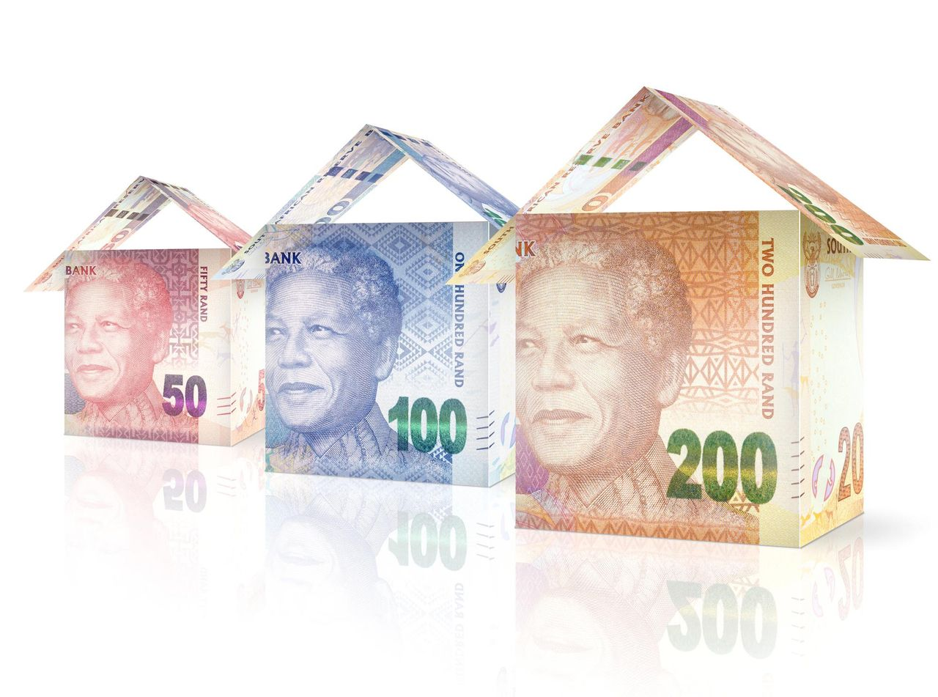
Environment APP Performance : Quarter 2
67%
APP Performance

Slide 4
Overview of Environment Quarter 2 Performance
Administration
Environment
11 indicators
5 indicators not achieved
6 achieved
13 indicators
3 indicators not achieved
10 indicators achieved
55%
77%

Slide 5
Areas of Performance

Slide 6
Programme | Achievements
Administration 55% | 100% (100%) Reduction in irregular expenditure 59% (40%) total procurement that targets businesses owned by Women 31% (30%) total procurement that targets businesses owned by Youth 100% (100%) procurement implemented through the open tender system 5 046 (5000) Work opportunities created through Tshepo 1 million 98% (90%) Ntirhisano commitments achieved | % Achievement against Annual Target 100% 59% 31% 100% 98% 96%

Slide 7
Programme | Achievements
Environmental Management 77% | 28 (25) Administrative enforcement notices issued for non-compliance with environmental management legislation. 9 (9) Completed criminal investigations were handed to the NPA for prosecution. 93 (75) Compliance inspections were conducted. 100% (100%) Complete S24G applications were finalized within 60 working days of the date of receipt of proof of payment of section 24G administrative fine. 100% (100%) Completed atmospheric emission licenses were issued within legislated timeframes. 100% (100%) Complete Waste License applications were finalised within legislated time-frames. 335 (163) Waste Certificates were issued. 17 (10) Health Care Waste Approvals were issued 26 (15) Environmental capacity building activities were conducted. 184 (70) Environmental awareness activities were conducted. | % Achievement against Annual Target 50% 50% 70% 100% 100% 100% 80% 60% 76% 138%

Slide 8
Areas of Non-Performance

Slide 9
Administration
Outputs/ key deliverables | Annual Target | Quarter 2 Target | Actual Q2 Performance | Average Variance | Progress to date Against AT
Invoices paid within 10 working days of receipt (85% of Invoices were paid within 30 days of receipt, and 57% of all invoices received were paid within 15 days) | 100% | 100% | 53% | -47% | 83%
Reason for Deviation | Corrective Measures
Cash flow issues were experienced from April 2024, because of the 6000 EPWP workers’ stipends being paid from Goods and Services Budget. This impacted on the cash flow availability to pay suppliers invoices. | The Department has escalated the cash flow issues to Provincial Treasury .

Slide 10
Administration
Outputs/ key deliverables | Annual Target | Quarter 2 Target | Actual Q2 Performance | Average Variance | Progress to date Against AT
Department spend in township | 40% | 40% | 20% | -20% | 20%
Total procurement that targets businesses owned by Military Veterans | 0.2% | 0.2% | 0% | -0.2% | 0.2%
Total procurement that targets businesses owned by Persons with Disabilities (PwDs) | 7% | 7% | 2.2% | -4.8% | 2.2%
Clean audit outcome obtained from the Auditor-General | Clean Audit | Clean Audit | Unqualified Audit | Unqualified | Unqualified
Reason for Deviation | Corrective Measures
Although the Department targeted township –based businesses as well as businesses owned by designated groups when request for procurement for </= R1000 000 are made, the department did not achieve its set targets as was anticipated. During the reporting period under review, most of the targeted groups were found to be non-tax compliant. There was a material adjustment to the annual performance report and non-compliance to legislation, which prevented the department from achieving a clean audit. | The Department appointed a task team incorporating BBBEE unit, transformation and SCM, to draft a plan to address challenges with regards to targets to targets in relation to township-based businesses and preferential procurement for designated groups Implement the AGSA 2023/24 audit improvement plan in order to achieve clean audit in 2024/25 FY.

Slide 11
Environment Management
Outputs/ key deliverables | Annual Target | Q2 Target | Actual Q2 Performance | Average Variance | Progress to date Against AT
Percentage of complete EIA applications finalized within legislated timeframes | 100% | 100% | 96% | -4% | 96%
Complete biodiversity management permits were issued within legislated timeframes. | 90% | 90% | 86% | -4% | 86%
Trees (greening) planted | 300 000 | 150 000 | 28 379 | -121 621 | 9%
Reason for Deviation | Corrective Measures
Ten applications were completed outside the stipulated time frames, due to the internal administrative errors. | Introduction of centralized database/spreadsheet of all applications to enable managers to track files that are likely to be out of the timeframe. Weekly updates of applications that requires extensive consultation with other Directorates will also be introduced.
Intermittent/unstable SITA network connectivity to access National systems | Prompt reports of incidents by system end users
There was no enough budget to procure the required number of trees for Q2. | More funds are needed to procure more trees to cover the shortfall.

