Slide 1
OVERSIGHT AND ACCOUNTABILITY IN THE GPL
Members Orientation
26 - 28 June 2024

Slide 2
PRESENTATION OUTLINE
Introduction
Oversight and accountability
The Sector Oversight Model (SOM)
Budget Cycle Model and its Mechanism
Committee Process
Questions to the Executive
Resolutions of the House
Motions
Scrutiny of Reports

Slide 3
Introduction
Within the context of Separation of Powers, the role of the Legislature as overseer of executive action makes it an influential player in the overall governance mechanism.
Legislatures develop internal mechanisms to enable oversight, incl. tools such as SOM, Inquires, Questions, Motions and Resolutions.
The effective and complementary use of all oversight tools is crucial for the success of oversight and thereby effective accountability by the executive.
The SOM evolved from the PEBA, and later adopted and implemented across the Legislative Sector as the Sector Oversight Model (SOM) – with GPL playing a key role in this process.
Thirty (30) Years since the dawn of democracy, a lot of lessons have been derived from the implementation of the model, the use of legislature Questions, Motions, Resolutions and Committee Inquiries - with successes and challenges.

Slide 4
OVERSIGHT & ACCOUNTABILITY

Slide 5
Defining Oversight and Accountability
Oversight:
In this context…Oversight can be viewed in terms of what legislatures and their members do. This involves reviewing, monitoring and supervising the executive and the programmes, activities and policy implementation of other organs of state.
It is defined as proactive interaction initiated by a legislature with the Executive and administrative organs - that encourages compliance with constitutional obligations on the Executive and administration to ensure delivery on agreed-upon objectives for achievement of government priorities (SOM)
Accountability:
“Accountability refers to institutionalized practices of giving an account of how assigned responsibilities are carried out.” Accountability simply means that those in power must be held accountable for their acts, omissions and decisions, including those affecting expenditures or policies.

Slide 6
Functions of Oversight
The function of oversight within the South African Legislative Sector context entails:
To detect and prevent abuse, arbitrary behavior, or illegal and unconstitutional conduct on the part of the government and public agencies;
Hold the government to account in respect of how taxpayers’ money is used;
Ensure that policies announced by the government and authorized by Parliament are implemented; and
Improve the transparency of government operations, thereby enhancing public trust in government which, in itself, is a prerequisite for effective policy delivery.

Slide 7
Why Legislatures Do Oversight
Amongst others, through oversight, legislatures seek to:
Oversee and approve the executive's legislative proposals, inclusive of appropriations; policy and legislative proposals…;
Scrutinize what the executive branch of government has done…;
Supervision of the activities of the executive branch;
Holding the executive accountable by overseeing its exercise of public power;
Thorough scrutiny of the executive’s implementation of, and adherence to the law.

Slide 8
GPL Oversight And Accountability
The legislature uses several tools to exercise its oversight mandate and holding the Executive accountable.
These include amongst others:
The Sector Oversight Model (SOM) which is inclusive of Committee Inquiries;
Questions to the Executive,
Motions,
Scrutiny of Reports,
Monitoring implementation of Resolutions of the House, etc.
The implementation of the tools is governed by the rules of the Legislature and relevant legislations
Central to the Legislature's execution of the oversight mandate is the Sector Oversight Model (SOM).

Slide 9
THE SECTOR OVERSIGHT MODEL (SOM)

Slide 10
The Sector Oversight Model (SOM)
The model (SOM) adapted from the GPL’s Programme Evaluation and Budget Analysis, is currently used by the sector as its guide for conducting oversight.
The development of the Model came as a result of the Speakers Forum’s initiative during the fifth legislature to improve and enhance the legislative sector’s performance on oversight.
It further served to ensure a coordinated approach to the sector’s application of oversight practice in each institution.
The model introduced an oversight regime based, less on institutional or political confrontation, but placing legislatures as a central component in the public service delivery machine.
This approach means that legislatures’ oversight role is exercised in pursuit of good governance, thereby making legislatures bear some responsibility for overall government performance.

Slide 11
The Sector Oversight Model (SOM) cont.
Oversight’ in the South African political context, as in many others, is customarily perceived as the purview of opposition politicians. Those exercising oversight are generally afforded the luxury of hindsight, and are ultimately divorced from the responsibility for failure.
The model attempts to redefine this image of oversight by introducing an oversight regime based less on institutional or political confrontation. Instead, it tries to redefine legislatures as a central component in the public service delivery machine.
The redefinition rests on the understanding that if the legislatures’ oversight role is exercised in pursuit of good governance, then the legislatures too bear some responsibility for overall government performance.

Slide 12
The Sector Oversight Model (SOM) cont.
Given the state of affairs described above, it is necessary to identify the key elements of legislative oversight, that is, the evaluation of the efficacy of public service programmes and the appropriateness of financial resource allocations and management, and the relationships between these key elements. The result is a simple conceptual model that captures these elements and arranges them in an appropriate manner.
The activation of the PSOM requires separate instruments: the Budget Cycle Model (BCM); the Budget Information Matrices (BIMs); and a Toolkit of basic performance evaluations and budget analyses.

Slide 13
BUDGET CYCLE MODEL & ITS MECHANISM

Slide 14
Budget Information Matrices
The matrices contain a collection of various information pertaining to a specific Committee – thereby informing a committee as it implements the SOM imperatives.
This information includes speeches, e.g. SONA, SOPA, Minister (MEC) of Finance speech, departmental reports, policy literature, database of experts, amongst others.
The Committee is therefore able to tap into this information to augment its oversight processes.
Information Officers are assigned to the Committees to perform this role.

Slide 15
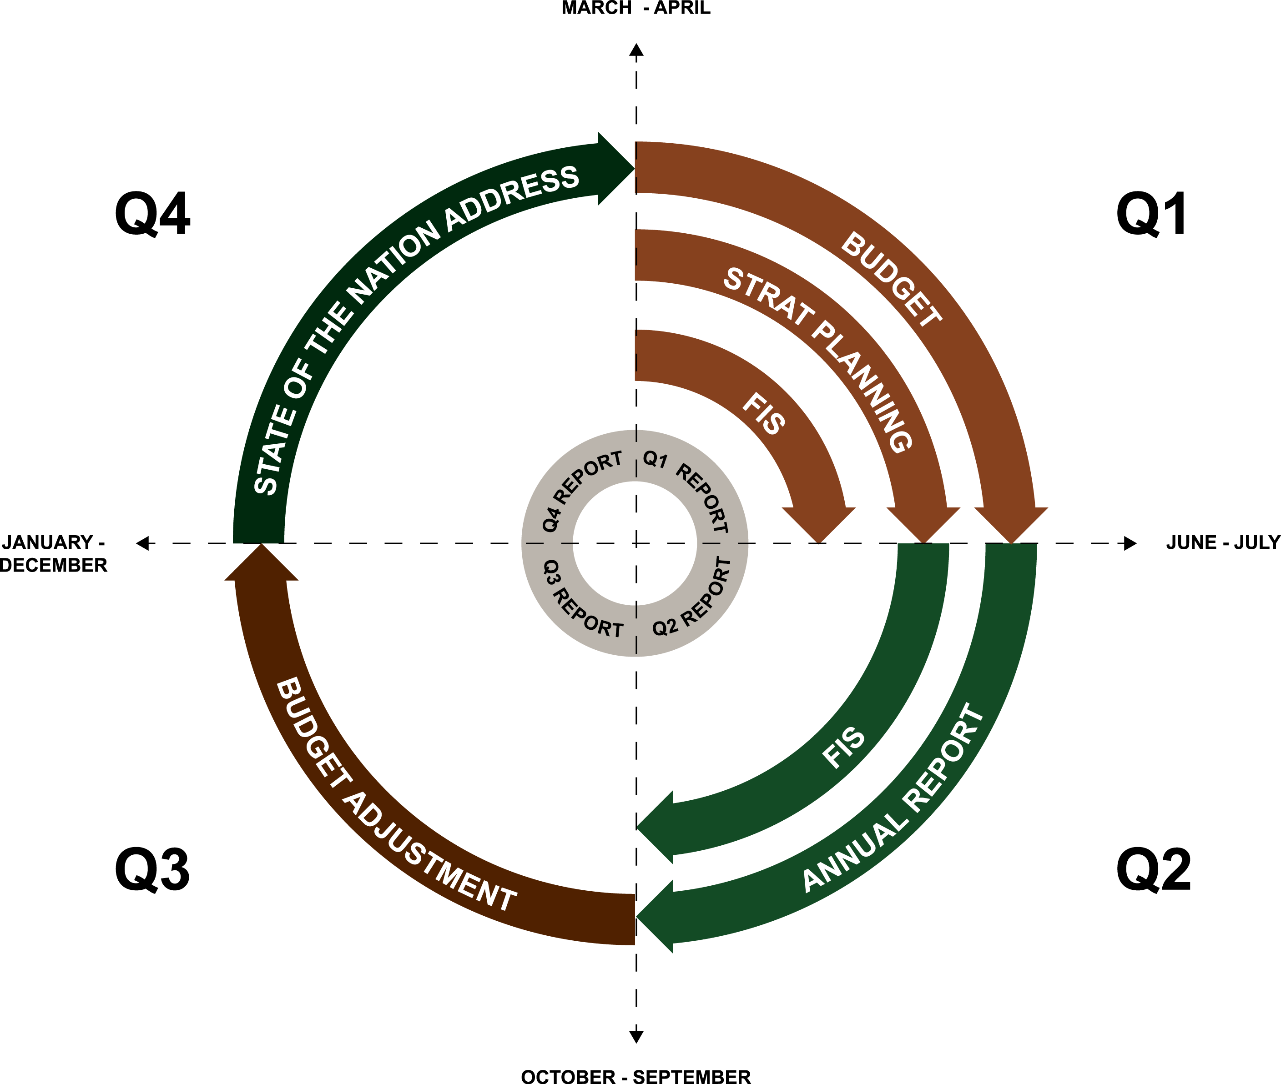
Budget Cycle Model & Its Mechanisms
Oversight cycle depicted represents how a legislature conducts oversight over the work of government.
The diagram highlights the different types of oversight mechanisms that are conducted during different times of the year.

Slide 16
Budget Cycle Model & Its Mechanisms cont.
Quarter 1 – Activities include – Budget, Strategic Planning, Quarterly Report and FIS
Quarter 2 – Activities include – Annual Report, FIS, Quarterly Report, etc.
Quarter 3 – Activities include – Budget Adjustment Process; Quarterly Report
Quarter 4 – Activities include – State of the Nation/Province Address; Quarterly Report
NB!
Consideration of Quarterly reports features throughout the cycle.
The processes often overlap through the 4 Quarters.

Slide 17
Budget Cycle Model & Its Mechanisms cont.
PRIORITIES
INPUTS
OUTPUTS
OUTCOMES
Appropriation Bill
Portfolio Budget
Portfolio Budget
Portfolio Budget
Portfolio Budget
1st Quarterly Report
4th Quarterly Report from Last Year
Focused Intervention Study 1
Focused Intervention Study 1
2nd Quarterly Report
Auditors Report on Previous Year
Annual Report of
Last Year
Agreement on Priorities and performance plans
Annual Report of
Last Year
Focused Intervention Study 2
3rd Quarterly Report

Slide 18
COMMITTEE PROCESS

Slide 19
Typical Committee Process
In consideration of any of the SOM imperatives, a committee would follow more or less the following process:
Departmental Report or Budget is referred to each Committee
MEETING NO.1: Briefing by Researcher (analysis) & Coordinator (past positions on recurring issues; stakeholder submission & other info)
Information Officer compiles relevant info including media reports; journal articles, etc.
Researcher conducts critical program evaluation & budget analysis
MEETING NO.2: Dept. presents Report or Budget. Committee asks questions & deliberates (informed by Researcher’s analysis & other info.).
Coordinator compiles relevant info, solicits submissions from stakeholders
MEETING NO.3: Committee Deliberates. (If necessary, Department is required to come back to provide further clarity). Key issues are captured.
MEETING NO.4: Further deliberations; Key issues are captured & draft report generated (Chairperson; sub-committee; Coordinator.
MEETING NO.5: Draft report deliberated, finalized & adopted. Committee Oversight Report tabled on ATC.

Slide 20
Typical Committee Process cont.
It is important to note that some of the processes may occur concurrently; or
Committee processes may take place in a shorter space of time (with a limited number of meetings) than those stipulated.
The number of meetings depends on the allocated time as per the Programme of the Legislature.

Slide 21
Committee Inquiries
In terms of Section 115 of the Constitution of the Republic of South Africa, 1996, Legislatures have powers to:
Summon of any person to appear before it;
To give evidence on oath or affirmation, or to produce documents;
Require any person or provincial institution to report to it;
Compel, in terms of provincial legislation or the rules and orders, any person or institution to comply with a summons or requirement as contemplated in section 115(a) or (b); and
To ensure the provincial legislature’s constitutional mandate on oversight is further entrenched.

Slide 22
Committee Inquiries cont.
The Committee Inquiries Act, No.8 of 2009 seeks to implement the Committee Inquiries by:
Facilitating oversight of the provincial legislature over provincial departments and other provincial organs of state;
Establishing procedures for committee inquiries;
Ensuring the privilege of witnesses, officials and other persons from legal proceedings;
Ensuring the protection of information; and
Empowering committees to conduct inquiries on any area of competence of a provincial department or provincial organ of state.

Slide 23
Committee Inquiries cont.
Committee Inquiries enables legislatures to investigate and gain deeper understanding of government work, especially when faced with more intricate areas of government work that would require inquiry.
Committee inquiries provide a unique opportunity to Committees of the House to further solicit information as part of oversight work through summoning of witnesses.
This initiative is envisaged to enhance the other oversight methodologies applied by Committees of the House.
The expectation is that Committees of the House should conduct in-depth investigations/interrogation of the financial and non-financial performance of their respective departments which will be within their oversight purview.
This should then lead Committees to institute an inquiry where witnesses may be called to provide evidence to the matter in question.

Slide 24
QUESTIONS TO THE EXECUTIVE

Slide 25
Questions to the Executive
Questions is an oversight mechanism by which information is solicited from the Executive by the Legislature through its Members. Chapter 9 of the Standing Rules regulates in detail this oversight mechanism including the form, content and admissibility of questions.
There are two types of questions:
Questions for Oral Reply, which are scheduled for reply every Tuesday, when there is a House Sitting; and
Questions for Written reply, which are sent to Departments and published in the Question Paper every Tuesday of the week and should be responded to within (10)ten working days after publication of the question paper.

Slide 26
Questions to the Executive cont.
Questions for Oral reply may contain up to five subdivisions and a maximum of (4) four questions may be put to a Department per Question time. Only (2)two questions for Oral Reply are allowed per Member on a question day. The reply and supporting documents must be submitted to the Legislature for publication.
Questions for Written Reply may contain up to ten subdivisions. A member is permitted to ask (3) three questions per week and NCOP Permanent delegates may ask only (1) one question per week.
Urgent Questions is another form of Questions for Oral Reply, it must be submitted to the Speaker at least two hours before a Sitting. It must require urgent response from the Executive Council and may not concern a matter of privilege.

Slide 27
Questions to the Executive cont.
Questions is an oversight mechanism by which information is solicited from the Executive by the Legislature through its Members. Chapter 9 of the Standing Rules regulates in detail this oversight mechanism including the form, content and admissibility of questions.
There are two types of questions: Questions for Oral Reply, which are scheduled for reply every Tuesday, when there is a House Sitting and Questions for Written reply which are sent to Departments and published in the Question Paper every Tuesday of the week and should be responded to within (10) ten working days after publication of the question paper.
Questions for Oral reply may contain up to five subdivisions and a maximum of (4) four questions may be put to a Department per Question time. Only (2) two questions for Oral Reply are allowed per Member on a question day. The reply and supporting documents must be submitted to the Legislature for publication.

Slide 28
Questions to the Executive cont.
Questions for Written Reply may contain up to ten subdivisions. A member is permitted to ask (3) three questions per week and NCOP Permanent delegates may ask only (1) one question per week.
Urgent Questions is another form of Questions for Oral Reply, it must be submitted to the Speaker at least two hours before a Sitting. It must require urgent response from the Executive Council and may not concern a matter of privilege.

Slide 29
RESOLUTIONS OF THE HOUSE
MOTIONS
SCRUTINY OF REPORTS

Slide 30
Resolutions of the House
Resolutions are decisions of the House. They can emanate from a Committee report with recommendations, a Debate on a Motion or during any House Sitting.
Depending on the matter tabled for a resolution before the House, the Executive may be required to act on them and submit a response to the Legislature within the stipulated time period.
Responses received are analyzed by the House Committees to verify adherence to the House resolutions as intended.
Where non-satisfactory responses are received, follow-ups with the relevant authority are made.
A Member of the Executive Council who has not responded/implemented a resolution must provide reasons, corrective measures and plans to implement the resolution – In accordance with the standing rules.
Resolution tracking thus forms part of the legislature’s continuous oversight over the executive.

Slide 31
Motions
Motions can be introduced by members for the House to adopt a resolution with or without debate.
A motion may, amongst other things, propose that the House resolves to:
Pass a Bill;
Censure a person or a body;
Adopt a report;
Make a recommendation[s] to the Executive;
Express an opinion;
Amend a motion before the House; and
Pass a motion pursuant to any specific section of the Constitution.

Slide 32
Scrutiny of Reports
In line with the Constitution of the Republic of South Africa, 1996, Public Finance Management Act, 1 of 1999, Departments are required to table: Annual Reports including audited financial statements not later than six month after the end of each Financial Year.
Quarterly Reports must be submitted within one month after the end of each quarter (July Q1, October Q2, January Q3 and April Q4). It is important that reports are signed off by the MECs and submitted on time.
The Reports performance information as prescribed by the GPL, Financial Statements on the format prescribed by Treasury and the Annual Report by the Auditor General. The reports, must contain both performance and financial information for the period under review as well as give an account of the implementation of all legislations in the area of responsibility.

Slide 33
Scrutiny of Reports cont.
Both Annual and Quarterly reports should respond to the Five-year strategic plan/Annual Performance Plan of the respective Department.
Reports are referred by the Speaker to Committees for scrutiny and reporting – Tabling in the House.
Thorough scrutiny on performance and financial information aims at gauging the departments’ progress in implementing their strategic plans, annual performance plans and utilization of resources. NB! Committees are to monitor departments’ progress in implementing the SDGs, NDP and the implementation of laws within their area of responsibility.

